Slide 1
Employee Data analytics using Excel
Name : RAKSHITHA A
Register No : 122202071(asunm1353122202071)
Department: B.com( corporate secretaryship)
College: Anna Adarsh College for Women.

Slide 2
Project Title
Employee performance Analysis using Excel

Slide 3
Agenda
1. Project statement
2. Project overview
3. End users
4. Our solution and proposition
5. Dataset description
6. Modelling Approach
7. Research and discussion
8. Conclusion

Slide 4
PROJECT STATEMENT
To Conduct a comprehensive analysis of current employee ratings to identify key trends, uncover areas needing improvement in core problems includes inconsistent performance, potential impact etc.

Slide 5
WHO ARE THE END USERS ?
HR Managers: To access overall employee performance trends identify training needs and use case metrics for recruitment and retention strategies. Department Heads: Use performance data to set goals. Performance Analysts: Generate reports and recommendations for optimising the performance management process.

Slide 6
OUR SOLUTION AND VALUE PROPOSITION
Sorting- Arrange in the Ascending Order Filtering- Filling, Adjusting columns Conditional Formatting- Highest To Lowest Pivot Chart- Summary Of Employee Performance Formulas- Excel Formulas Grap

Slide 7
DATASET DESCRIPTION
Business Units Covered: TNS BPC WBL CCDR NEL SVG MSC EW YZ
PL Employee Location: Chennai, Bangalore, Kerala, Rajasthan Performance Scores: Fully Meets: 14 Employees Exceeds: 6 Employees

Slide 8
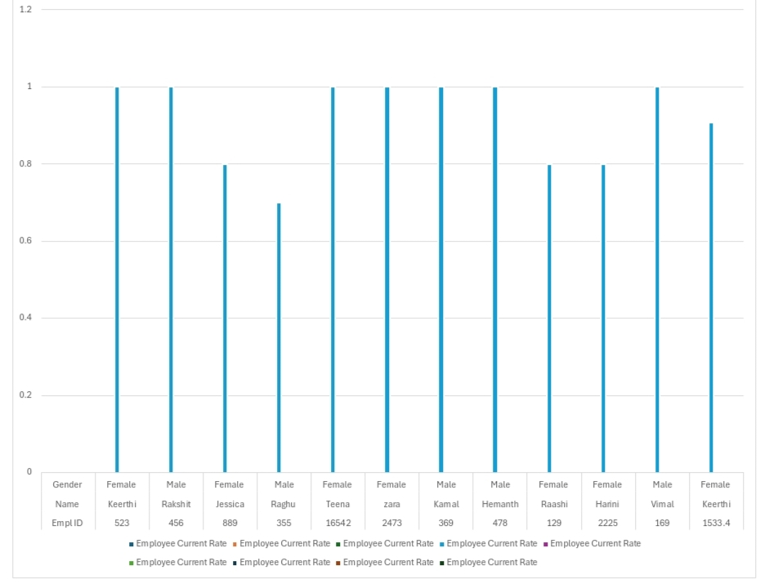

Slide 9
MODELLING APPROACH
Data Set: employee dataset Feature selection: work location Data Cleaning: missing value, irrelevant Formula-performance calculation, low, medium, high, sum Pivot table and chart: summary.

Slide 10
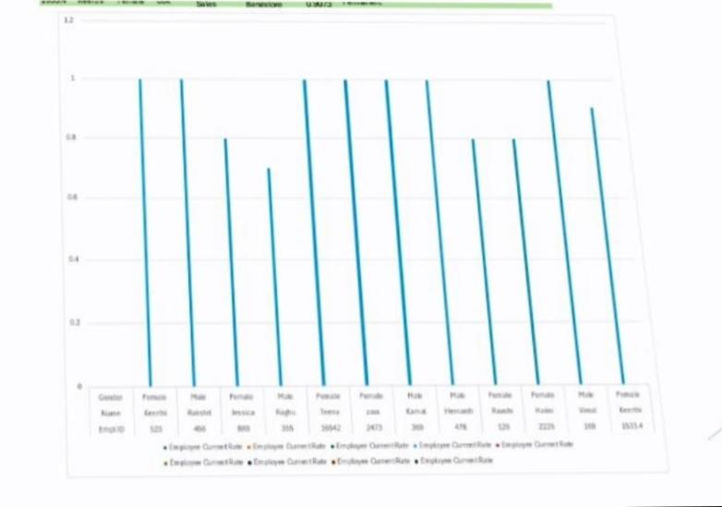
RESEARCH AND RESULT

Slide 11
CONCLUSION
The data suggested a balanced performance distribution among the employees with opportunities for further development and recognition. Continuous monitoring and targeted interventions

